Slide 1

The Practical Stuff
Sixth Form ID Cards
Sixth Form Subs
GCSE Results Day & Letting Us Know

Slide 2
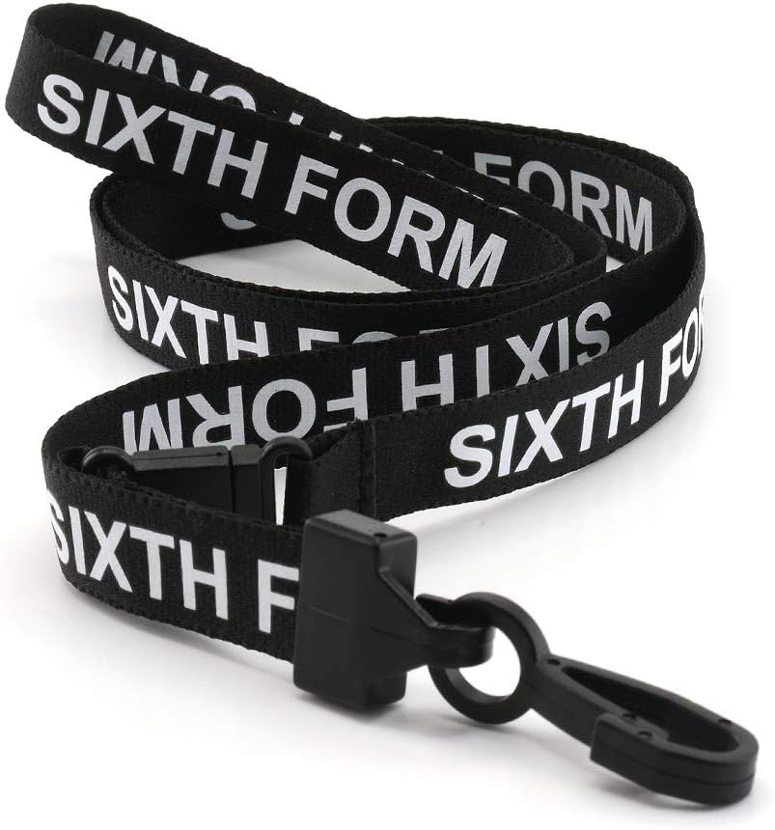
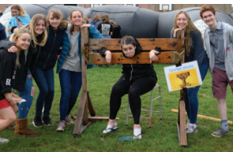
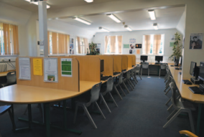
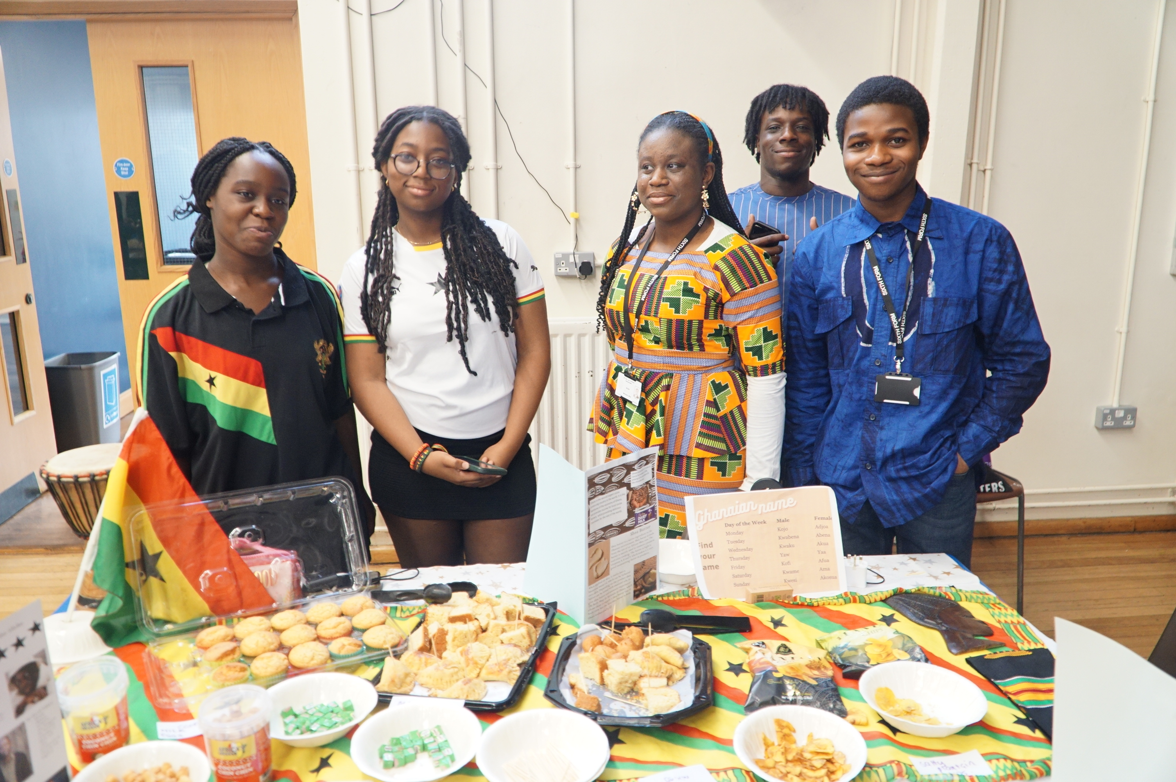
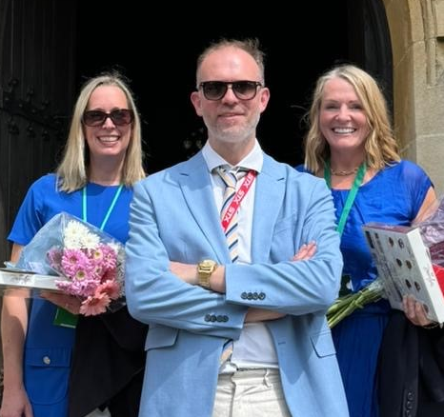
Sixth Form ID Cards
All Sixth Formers are required to display a Photo ID Card which must be worn at all times while on site. This constitutes an important part of the St George’s safeguarding protocols. You will need your ID Card during examinations.
Once issued if you forget or lose your Photo ID Card you must obtain a temporary ID badge from Sixth Form Office (something of value is required as a deposit). Replacement Photo ID cards can be purchased from Mrs Beaman for £5.
Sixth Form Subs
We ask our Sixth Form students to make a two year contribution of £35 towards the St George's Sixth Form Fund.
We use your contributions towards various things, including reprographics and printing credits, students’ ID card and lanyards and supporting sixth form events like induction day, culture day, welcome bbq and leavers day.

Slide 3




GCSE Results Day & Letting Us Know
Please upload a photo of your statement of results to Applicaa.
So it's Thursday 21 August and you have your results in your hand …. What happens next? Firstly hold on tight to your Statement of Results – you will need to show this to confirm your results.
The conditional offer made to you was subject to you receiving the necessary entry requirements which is a minimum of five full GCSE grades 9-5, which must include both English (language or literature) and Mathematics, with three passes at grade 6 or above. In addition there are specific entry requirements for each course which can be found on the St George's school website, Sixth Form Prospectus.
Where do I go now ...
I got the required grades and
want to confirm my place at St
George’s Sixth Form.
Accept your offer by logging into your Applicaa account.
Upload a photo of your statement of results.
Submission Deadline
Friday 22 August 12 noon
I did meet the overall grade requirements but I want to change
one of my subject choices.
You must come and see us in person!
During this time we are unfortunately unable to receive calls or respond to emails.
Sixth Form Team will be on site Thursday 21 August 2 - 4 pm
Unfortunately we cannot accommodate you outside of these times.
Submission Deadline
Friday 22 August 12 noon
I did not meet the overall
grade requirements but still wish to take up my place in Sixth Form
You must come and see us in person!
During this time we are unfortunately unable to receive calls or respond to emails.
Sixth Form Team will be on site Thursday 21 August 2 – 4 pm
Unfortunately we cannot accommodate you outside of these times.
Submission Deadline
Friday 22 August 12 noon
I do not wish to take up my
place at Sixth Form.
People do change their minds
and you may decide not to join us,
but please let us know .
results@stgeorges.herts.sch.uk
Title your email - Offer Decline
Submission Deadline
Friday 23 August 12 noon

