Slide 1

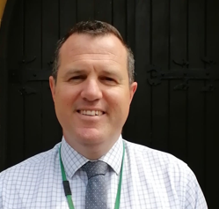
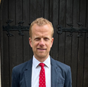
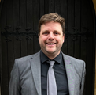
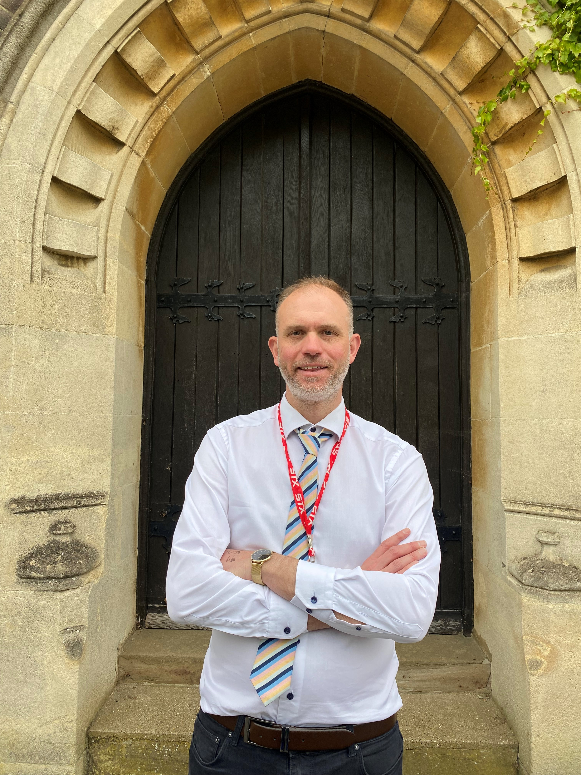
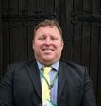
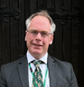
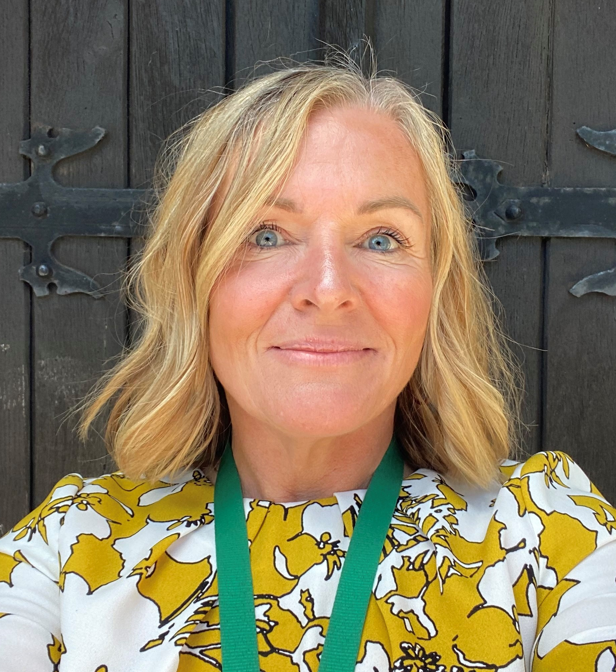
St George’s Sixth Form
6thformadmin@stgeorges.herts.sch.uk 01582 716254
Mr Cullis
Assistant Head Teacher
Sixth Form Education
Mr J Ellis
Deputy Director of Learning
Sixth Form Education
Mrs Beaman
Sixth Form Operational
Support Coordinator
Head of House
Mr Day Mr Ede
Goddard Monk
Mr Harris Mr Murris
Watts Grant

